Slide 1

BANGALORE INSTITUTE OF TECHNOLOGY
Department of Information Science and Engineering
SOFTWARE TESTING LAB (17ISL67)
TOPIC:JUNIT TESTING TOOL

Slide 2
Submitted By
SRINIVASA V 1BI17IS048
Under the guidance of
Mrs VEDASHREE T K
Assistant Professor
Dept. of ISE ,BIT

Slide 3
SOFTWARE TESTING
SOFTWARE TESTING is defined as an activity to check whether the actual results match the expected results and to ensure that the software system is Defect free.
It involves execution of a software component or system component to evaluate one or more properties of interest.
Software testing also helps to identify errors, gaps or missing requirements in contrary to the actual requirements.
It can be either done manually or using automated tools.

Slide 4
Why is Software Testing Important?
Testing is important because software bugs could be expensive or even dangerous. Software bugs can potentially cause monetary and human loss, and history is full of such examples.
In April 2015, Bloomberg terminal in London crashed due to software glitch affected more than 300,000 traders on financial markets. It forced the government to postpone a 3bn pound debt sale.
Nissan cars have to recall over 1 million cars from the market due to software failure in the airbag sensory detectors. There has been reported two accident due to this software failure.
Some of the Amazon’s third party retailers saw their product price is reduced to 1p due to a software glitch. They were left with heavy losses.
Vulnerability in Window 10. This bug enables users to escape from security sandboxes through a flaw in the win32k system.
In 2015 fighter plane F-35 fell victim to a software bug, making it unable to detect targets correctly.

Slide 5
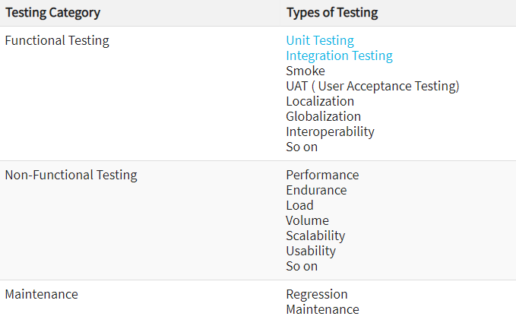
Different types of testing

Slide 6
JUNIT
JUnit is a Regression Testing Framework used by developers to implement unit testing in Java, and accelerate programming speed and increase the quality of code.
JUnit Framework can be easily integrated with either of the following −
Eclipse
Ant
Maven

Slide 7
Features Of JUnit Test Framework
JUnit test framework provides the following important features −
Fixtures
Test suites
Test runners
JUnit classes

Slide 8
What is a Unit Test Case?
A Unit Test Case is a part of code, which ensures that another part of code (method) works as expected. To achieve the desired results quickly, a test framework is required.
JUnit is a perfect unit test framework for Java programming language. A formal written unit test case is characterized by a known input and an expected output, which is worked out before the test is executed.
The known input should test a precondition and the expected output should test a post-condition.

Slide 9
ENVIRONMENT SETUP
JUnit is a framework for Java, so the very first requirement is to have JDK installed in your machine.
Step 1:Verify Java Installation in Your Machine
Step 2: Set JAVA Environment
Step 3: Download Junit Archive
Step 4: Set JUnit Environment
Step 5: Set CLASSPATH Variable
Step 6: Test JUnit Setup
Step 7: Verify the Result

Slide 10
Guidelines for using Junit
Create files and directories which are deleted after a test method has been run.
Fail a test if the specified timeout is exceeded before a test method has been run.
Configure an external resource such as a socket or a database connection before a test method is run and free the external resource after a test method has been run
Make sure you apply all the rules as mentioned above while writing the test classes and cases.

Slide 11
Creating a Test class
package assignment;
import java.util.Scanner;
public class calculatorPgm {
public static void main(String[] args) {
Scanner reader = new Scanner(System.in);
boolean i=true;
while(i) {
System.out.print("Enter two numbers: ");
double first = reader.nextDouble();
double second = reader.nextDouble();
System.out.print("Enter an operator (+, -, *, /): ");
char operator = reader.next().charAt(0);
double result;
switch(operator)
{
case '+':result=add(first,operator,second);
break;
case '-':result=sub(first,operator,second);
break;

Slide 12
case '*':result=mul(first,operator,second);
break;
case '/':result=div(first,operator,second);
break;
// operator doesn't match any case constant (+, -, *, /)
default:
System.out.printf("Error! operator is not correct");
return;
}
System.out.printf("%.1f %c %.1f = %.1f", first, operator, second, result);
System.out.println(" ");
System.out.println("enter f to end or some other key to enter other values:");
char s=reader.next().charAt(0);
if(s=='f' || s=='F')
i=false;
}
}

Slide 13
TEST CASE CLASS
package assignment;
import static org.junit.jupiter.api.Assertions.*;
import org.junit.jupiter.api.Test;
public class TestCases {
calculatorPgm pgm = new calculatorPgm();
@Test
void addtest() {
double result=pgm.add(100,'+',200);
assertEquals(300,result);}
@Test
void addtest1() {
double result=pgm.add(100,'+',200);
assertEquals(310,result);}
@Test
void addtest2() {
double result=pgm.add(-100,'+',200);
assertEquals(100,result);
}
}

Slide 14
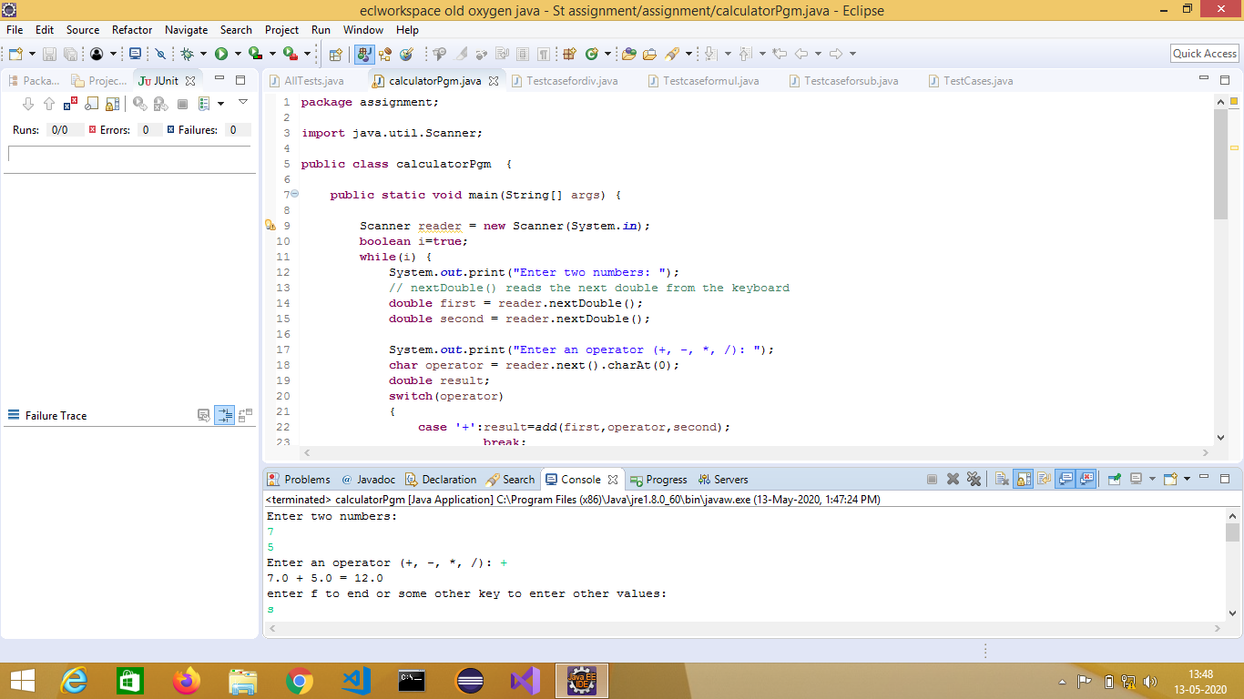
Screenshot of Test Class

Slide 15
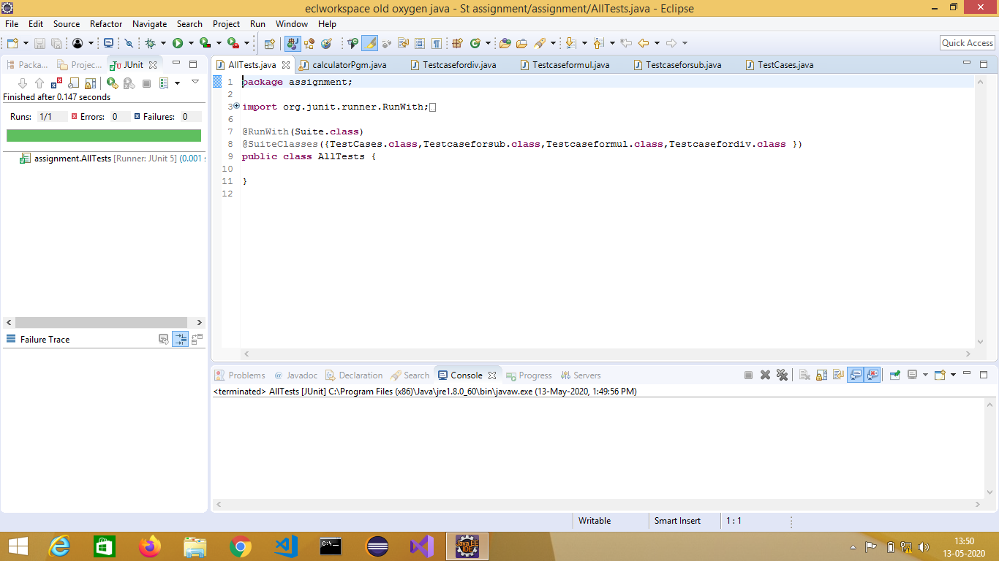

Slide 16
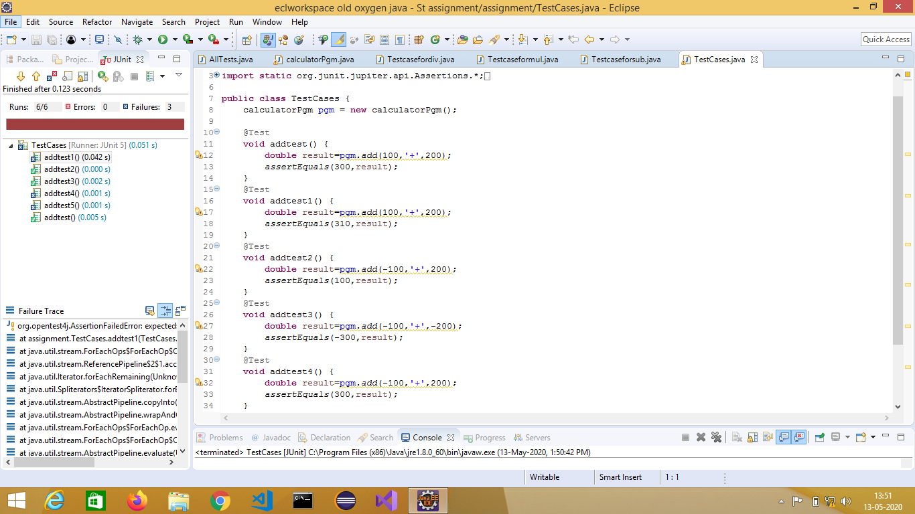
ScreenShot of Test Case Class

Slide 17
INDUSTRIAL APPLICATIONS
J-Unit is widely used testing framework along with Java Programming Language.
It helps us define the flow of execution of our code with different Annotations.
Most of the companies in their training period for the new recruiters conduct training for J-Unit testing tool.
User friendly, built in with eclipse makes it much popular than any other testing tools.
Time required to develop new features is faster.
Companies which use java as a backend for their development will use J-UNIT for testing purposes.

Slide 18
ADVANTAGES OF JUNIT
Enables writing test cases while developing the software that helps test early and detect issues.
Ensure the functionality is performing as expected every time the code is modified by the use of repeatable automated test cases.
Supported by all IDE including Eclipse, Intellij, Netbeans, RAD etc.
Integrates with Ant and Maven(CI) that enables execution of test suites or test cases as part of the build process, capturing test result and reporting.
Accurate, efficient testing process and manual based testing can be done.

Slide 19
DISADVANTAGES OF JUNIT
It cannot do dependency testing.
It's not suitable for higher level testing i.e. for large test suites.
Group testing cannot be done in J-Unit.
Can't create HTML reports of test cases. You need to use ANT to create tests HTML reports.

Slide 20
CONCLUSION
Most of the programmers use J-Unit as it is easy and does not take much effort to test. A simple green or red bar will show the actual result of the test. Junit makes life easy as it has its own set of libraries and annotations.
Therefore in conclusion it can be concluded that the J-Unit testing tool can be used to do manual testing in an efficient and robust manner
It also provides the user to set up his own test cases in order to test the given code in user-friendly environment of any type of IDE.

Slide 21
REFERENCES
Guru99.com - https://www.guru99.com/software-testing-introduction-importance.html
Tutorials Point - https://www.tutorialspoint.com/junit/junit_useful_resources.htm
Java T Point - https://www.javatpoint.com/junit-tutorial
Paul C Jorgensen – A Craftsman’s Approach
Mauro Pezze and Michal Young – Software Testing and Analysis – Process, Principles and Techniques

Slide 22


